Slide 1
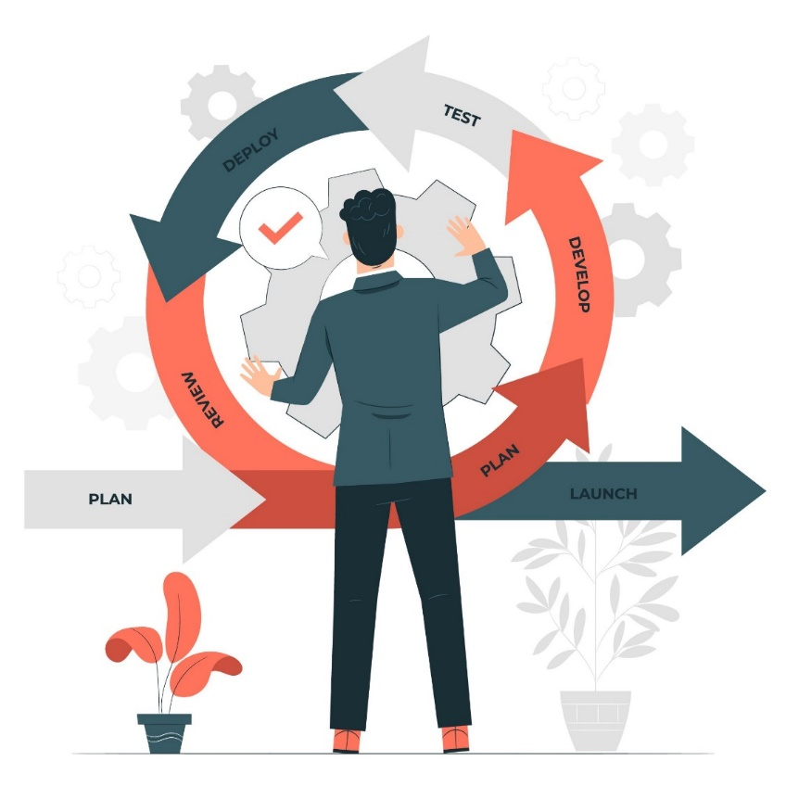

AGILE
METHODOLOGIES
Notes:
Welcome to Polyglot! This series is about Agile Methodologies, that helped thousands of software teams to deliver complex projects successfully.

Slide 2
Waterfall Model (SDLC)
Requirement Analysis
System Design
Implementation
System Testing
System Deployment
System Maintenance
Notes:
The Waterfall model is divided into the following phases:
Requirement Analysis – During this stage, the team gathers all possible system requirements and records them in a requirement specification document.
System Design – This phase involves creating detailed technical specifications and design documents, Planning the programming language, for example Java, PHP, .NET or database, may also be necessary in this step.
Implementation: This phase involves writing code and integrating it with other components of the system.
Testing: This phase involves verifying that the software meets the requirements and performs as expected.
Deployment: This phase involves installing the software on the target system and making it available to users.
Maintenance: This phase involves ongoing support and updates to the software to fix bugs, improve performance, and add new features.

Slide 3
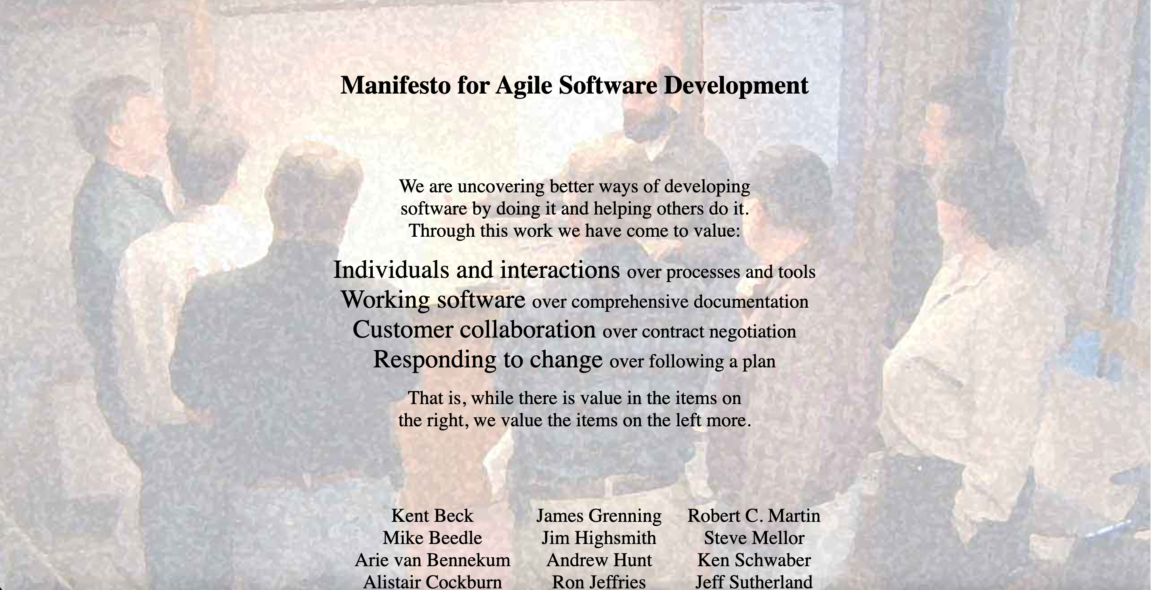

Agile Manifesto
A document that contains the core values and principles of agile software development.
Released in February 2001,at The Lodge at Snowbird ski resort in Wasatch mountain of Utah
Notes:
The Agile Manifesto is a document that contains the core values and principles of agile software development. It offered an alternative to traditional software development methodologies to improve upon existing software development processes, which were more complex and contained a lot of documentation.
The Agile manifesto was released in February 2001 at The Lodge at Snowbird ski resort in Wasatch Mountain, Utah. A group of seventeen leading software developers known as the Agile Alliance wrote the manifesto to create a new way of managing the software development process.

Slide 4
Four Core values of Agile Manifesto
Agile Methodologies
Traditional Methodologies
Individuals and interactions
Processes & Tools
Working software
Comprehensive documentation
Customer collaboration
Contract negotiation
Responding to change
Following a plan
Notes:
The Agile Manifesto defines four core values<break time='0.5s' />
Individuals and interactions over process and tools<break time='0.3s' />
Working software over comprehensive documentation<break time='0.3s' />
Customer collaboration over contract negotiation<break time='0.3s' />
Responding to change over following a plan<break time='0.5s' /> That is, while there is value in the items on the right, we value the items on the left more.
Individuals and Interactions: Agile places a strong emphasis on the importance of individuals and their interactions in the development process. This value stresses the need for self-organization, cross-functional teams, and face-to-face communication.<break time='0.5s' />
Working Software: Agile prioritizes working software as the primary measure of progress. This value encourages the rapid delivery of functioning software that can be tested and used by customers.
Customer Collaboration: Agile development requires close collaboration between the development team and the customer. This value emphasizes the importance of customer input, feedback, and active participation throughout the development process.
Responding to Change: Agile is characterized by its flexibility and ability to adapt to changing requirements and priorities. This value stresses the importance of being able to respond quickly and effectively to changes, both in the requirements and in the development process itself.<break time='1s' />
These values are intended to guide Agile teams in making decisions and solving problems during software development process.

Slide 5
Twelve Principles of Agile Manifesto
01
Customer satisfaction
07
Face-to-face communication
02
Early and continuous delivery of
software
08
Working software
03
Embrace change
09
Technical excellence
04
Frequent delivery
10
Simplicity
05
Motivated individuals
11
Self-organized teams
Collaboration of businesses
And developers
12
Regularly reflect and adjust
the way of work to improve.
06
Notes:
Agile manifesto also defines 12 principles : Customer satisfaction by early and continuous delivery of valuable software. Welcome changing requirements, even late in development. Agile processes harness change for the customer's competitive advantage. Deliver working software frequently, from a couple of weeks to a couple of months, with a preference to the shorter timescale. motivated individuals, Give them the environment and support they need, and trust them to get the job done.
Collaboration of businesses and developers ,Business people and developers must work together daily throughout the project. The most efficient and effective method of conveying information to and within a development team is face-to-face conversation. Working software is the primary measure of progress. Continuous attention to technical excellence and good design enhances agility. Simplicity–the art of maximizing the amount of work not done–is essential.
The best architectures, requirements, and designs emerge from self-organizing teams. At regular intervals, the team reflects on how to become more effective, then tunes and adjusts its behavior accordingly.

Slide 6


Agile Methodologies
Total Product Development is broken up into shorter, time-boxed periods - sprints or iterations.
An umbrella term for a group of technical and project management methodologies.
Lean
Scrum
Used for developing products and services iteratively.
At the end of each iteration, there is a shippable product called increment.
Extreme
programming
Kanban
Notes:
what is agile methodologies<break time='0.5s' />Agile Methodology' is an umbrella term for a group of technical and project management methodologies. In the software development industry, we use agile for developing products and services iteratively. The collective aim of these methodologies is to be responsive to the market and customer needs by providing faster and frequent delivery of value, and minimize the risk of wastage of time, effort and money.
Lean Methodology, eXtreme Programming, Scrum and Kanban are the most popular Agile Methodologies in the software industry. Agile methodologies break up the total product development into shorter, time-boxed periods, often called sprints or iterations that provide greater visibility of tasks, control on delivery and accuracy in estimates. At the end of each iteration, there is a shippable product called increment.

Slide 7



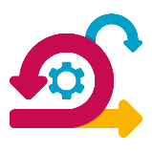


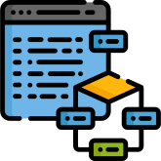

Most popular agile methodologies
Agile methodologies
Extreme programing
Scrum
Kanban
Scrumban
Lean
Notes:
Hai, welcome to Polyglot! Let us start our session.

Slide 8



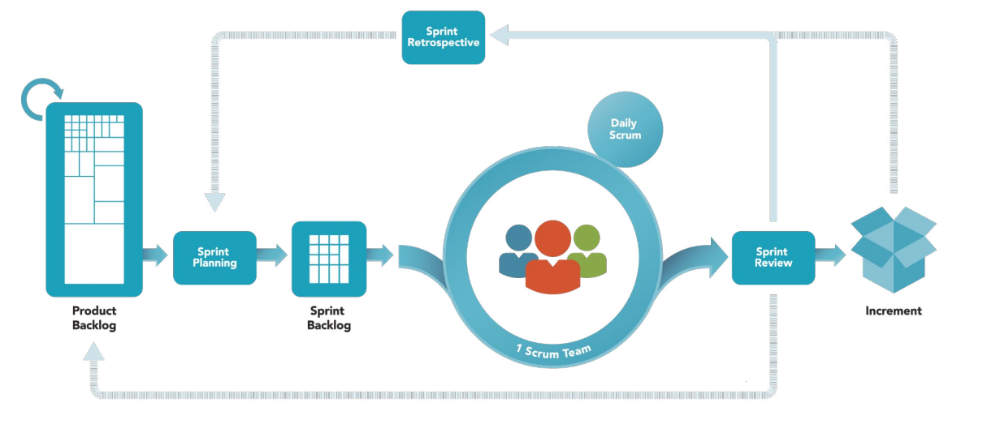
Scrum Framework
A lightweight framework for managing and organizing complex software projects.
software products are developed
in short cycles/iterations called
sprints.
Helps teams deliver high-quality products fast and efficiently.
a prioritized list
of features and
requirements for
the product
the sum of all the
product backlog
items completed
during a sprint
the work to be
done in the
current sprint
Notes:
The Scrum is a lightweight framework used for managing and completing complex projects. It is commonly used in software development, but can also be applied to other fields. It helps teams deliver high-quality products fast and efficiently
The framework is based on the principles of transparency, inspection, and adaptation. The Scrum framework consists of the roles, events, and artifacts.
The basic process of Scrum is: "The product owner prioritises the items in the product backlog." The team selects items from the sprint backlog to complete the sprint. Software products are developed in short cycles called sprints. The team works on completing the items during the sprint, and the team demonstrates the completed items and receives feedback at the sprint review. The team reflects on the sprint and identifies ways to improve at the sprint retrospective.
Also release a version of the product that includes all the features and improvements completed during the sprint, called an increment. The process is repeated with a new sprint.

Slide 9



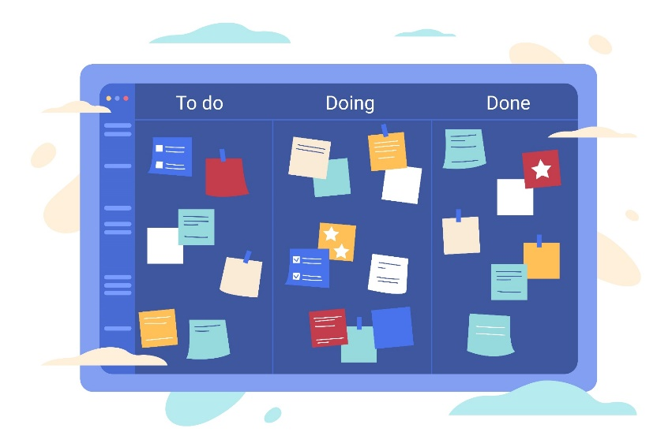


About Kanban
Method for managing and improving workflows.
Often used in combination with other agile methods, such as Scrum
It is based on the concept of "just-in-time" production.
Originated in Toyota in the 1940s.
work is represented by cards on a board, with each column on the board representing a different stage in the workflow.
Name Kanban originated from a Japanese word.
"Kanban” meaning “visual board”.
Notes:
Next, we'll talk about Kanban.
Kanban is a method for managing and improving workflows, originally developed in the manufacturing industry in Japan. It is based on the concept of "just-in-time" production, in which work is only started when it is needed, rather than being completed in advance. Kanban originated in Toyota in the 1940s. The name kanban originated from a Japanese word.”kanban” meaning “visual board”. The Kanban method provides a transparent way of visualizing the tasks and work capacity of a team.
In a kanban system, work is represented by cards on a board, with each column on the board representing a different stage in the workflow. As work is completed, it is moved from left to right on the board, allowing team members to easily visualize the progress of their work and identify any delays.
Kanban is often used in combination with other agile methods, such as Scrum, to improve the efficiency and effectiveness of the development process.

Slide 10

scrumban methodology
Allows teams to use the planning and prioritization tools of Scrum, while also utilizing the visual workflow management of Kanban.
A hybrid methodology that
combines all the
benefits of Scrum and
Kanban.
Enables teams to handle both incremental and evolutionary changes in product development.
Flexible enough to be used for both short-term and long-term projects.
Notes:
The next one is the Scrumban methodology. Scrumban is a hybrid methodology that combines all the benefits of Scrum and Kanban to create a more flexible and efficient approach to project management. It allows teams to use the planning and prioritization tools of Scrum while also utilizing the visual workflow management of Kanban. This creates a more adaptive approach to project management that can better handle changes and uncertainty. That enables teams to handle both incremental and evolutionary changes in product development. This methodology is flexible enough to be used for both short-term and long-term projects.

Slide 11


Slide 12

Agile Methodologies
Scrum
Kanban
Lean Software Development
Scrumban
Extreme Programming
Notes:
Congratulation… After the completion of this session, we get a brief description of popular Agile methodologies, including Scrum, Kanban, Lean, Scrumban, and Extreme Programming. Scrum is a framework for managing and completing complex projects, typically used for software development. Kanban is a method for managing and improving workflows and is often used in manufacturing and service industries.
Lean is a methodology that emphasizes the elimination of waste and continuous improvement and is often used in the manufacturing and healthcare industries. Scrumban is a hybrid methodology that combines elements of both Scrum and Kanban.
Extreme Programming (XP) is a software development methodology that emphasizes the values of simplicity, communication, feedback, and collaboration. It is characterized by a focus on frequent releases in short development cycles and a heavy emphasis on teamwork and collaboration.

Slide 13
Lean software Development
Based on the principles of Lean
Manufacturing.
Aim is to create software that is delivered
Quickly, with a minimum of waste and
rework
Continuous improvement, rapid prototyping,
And frequent feedback from end users.
first developed by Toyota
Notes:
Lean methodology <break time='0.5s‘/> Lean software development is a methodology for creating software that is based on the principles of Lean Manufacturing and Lean Startup. The goal of lean software development is to create software that is delivered quickly, with a minimum of waste and rework, and that meets the needs of the customer. This is achieved by focusing on continuous improvement, rapid prototyping, and frequent feedback from end users.
Lean software development also emphasizes the importance of removing unnecessary features and focusing on delivering the most value to the customer with the least amount of work. which were first developed by Toyota and have been widely adopted in various industries. Most automobile manufacturers practice this methodology like Nissan , ford..

Slide 14

Extreme programming
Ex
Rapid development cycle
Frequent delivery of working software
Continuous integration
and testing
Type of agile software development methodology.
Designed to improve software quality and responsiveness to changing customer requirements.
Based on a set of values and principles.
Pair programming
Test-Driven development
Continuous integration
Notes:
Now we discuss Extreme programming. Also known as XP. XP is a software development methodology that was designed to improve software quality and responsiveness to changing customer requirements. It is a type of agile software development that emphasizes rapid development cycles, frequent delivery of working software, and continuous integration and testing. XP is based on a set of values and principles , that prioritize people and interactions, working software, and customer collaboration.
It is intended to be a lightweight, flexible approach that can be adapted to a wide range of projects and environments. Some of the key practices of XP include pair programming, test-driven development, and continuous integration.

